Slide 1
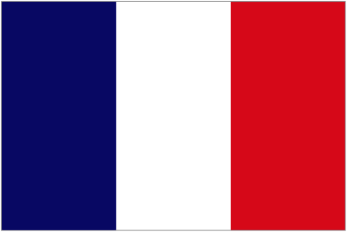
FRANCE
The most beautiful country in the world

Slide 2
Outlines
Map
Signifiant Places
French food

Slide 3
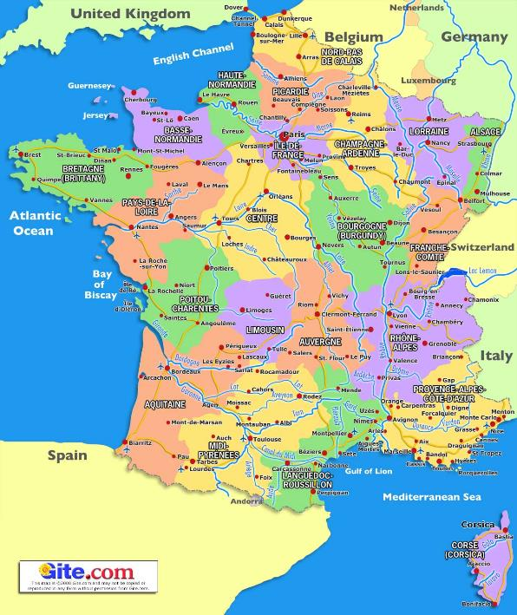
Map
BANDOL TOULON
PARIS
800KM

Slide 4
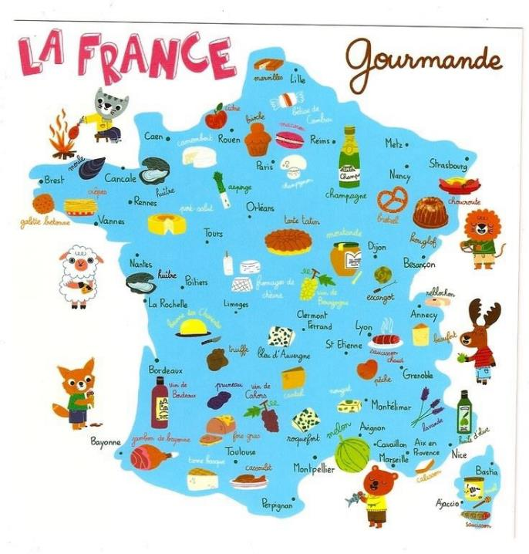
Map
French food according to French region

Slide 5
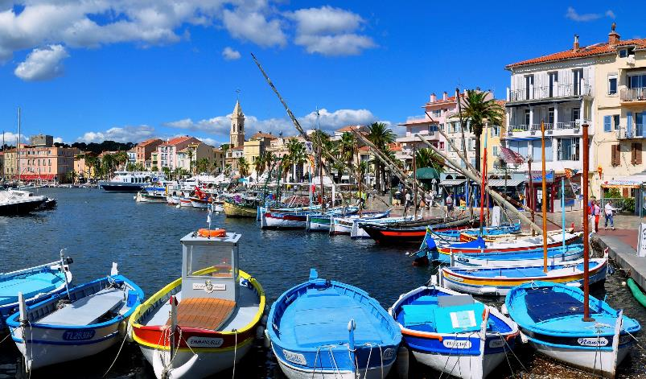
My City
Sanary sur mer

Slide 6
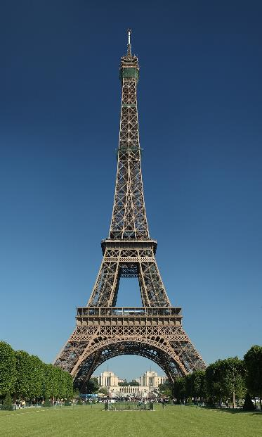
Signifiant Places
Eiffel Tower
Gustave eiffel
1889 World’s Fair

Slide 7
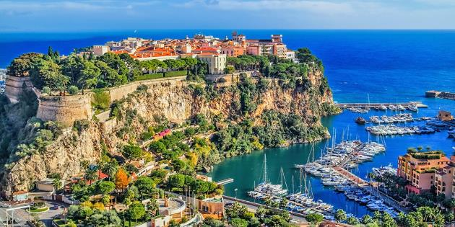
Signifcant Places
French Rivera
Famous Festival

Slide 8
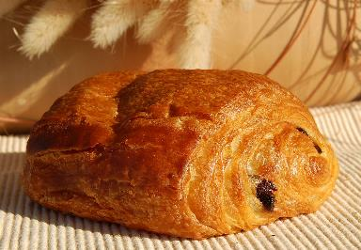
French Food
Pain au chocolat
French Biscuit

Slide 9
References
https://static.openfoodfacts.org/images/products/301/776/000/2073/front_fr.26.400.jpg
https://www.oliverstravels.com/blog/provence-alpes-cote-dazur-travel-guide/
https://www.gite.com/france-guides/Map-of-France.php
http://www.flags.net/images/largeflags/FRAN0001.GIF

