Slide 1
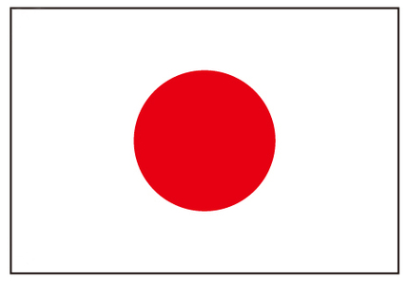
Japan

Slide 2
FOOD

Slide 9
PUBLIC TRANSPORTATION

Slide 10
Shinkansen

Slide 12
LANDSCAPE

Slide 13
Fuji Mount

Slide 14
Cherry Blossoms

