Slide 1
UAE
By Mohamed
Fall 2017

Slide 2
The UAE flag
Each color represent a thing

Slide 3
The map and the city

Slide 4
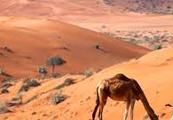
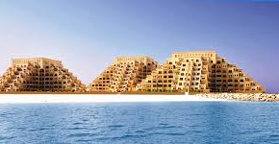
My city

Slide 5
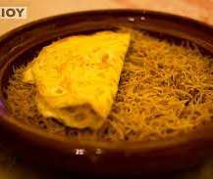
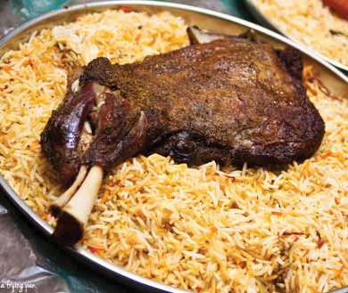
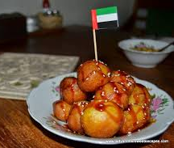
Food

Slide 6
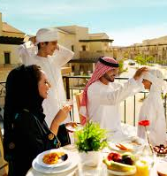
The life style in the UAE

