Slide 1
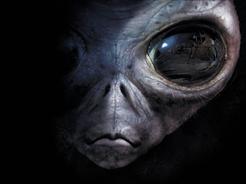
Life on Another Planet
By: Leonardo Stolze

Slide 2
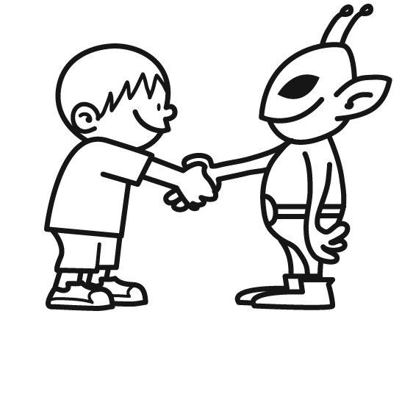
Outline
Theory of life
Reasons to don’t believe
Reasons to believe
Last News
Things to Think About and Go Crazy
Conclusion
Source

Slide 3
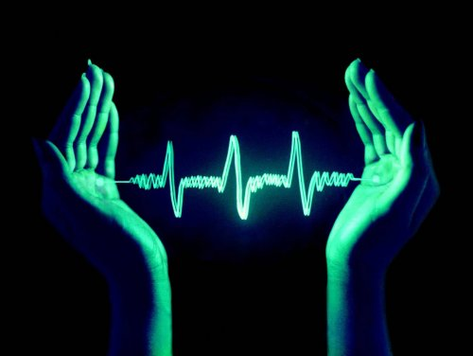
What is Life?

Slide 4
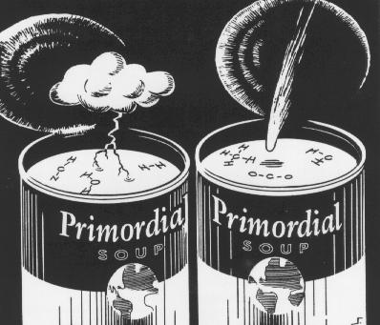
Theory of life

Slide 5
Reasons to Don’t Believe
British scientist – Nick Lane
Almost impossible to happen
His reasons is unfounded

Slide 6
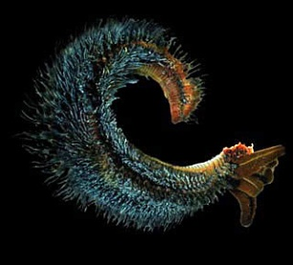
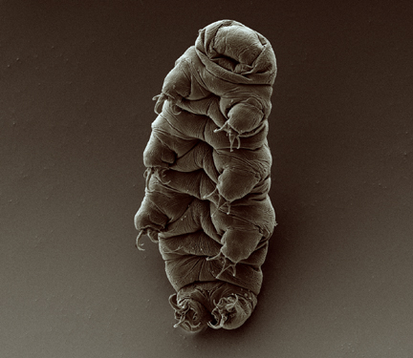
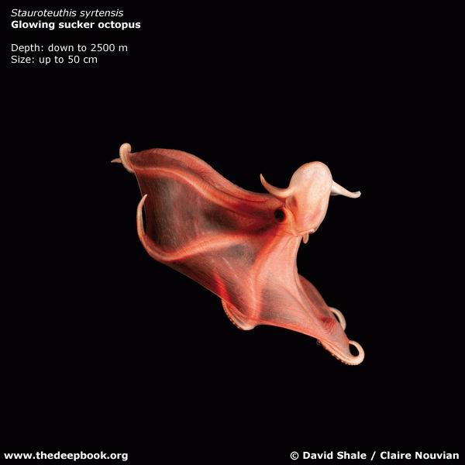
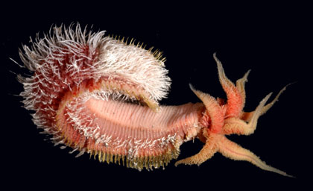
Seven Reasons to Believe
First
Extremophiles – What are they?

Slide 7
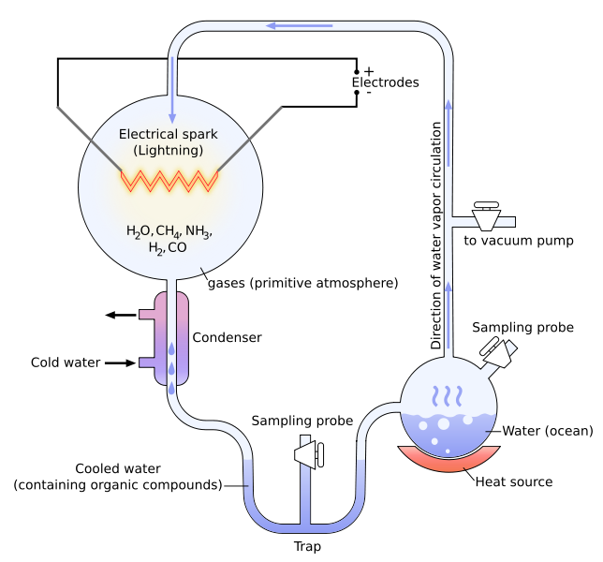
Seven Reasons to Believe
Second
Same ingredients

Slide 8
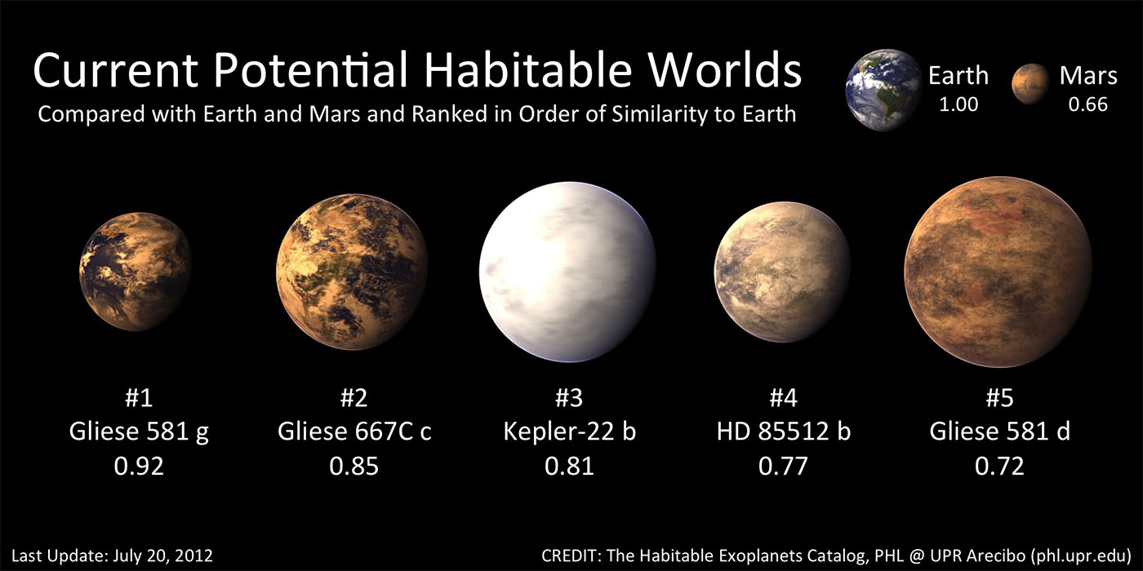
Seven Reasons to Believe
Third
New planets being discovered every time

Slide 9
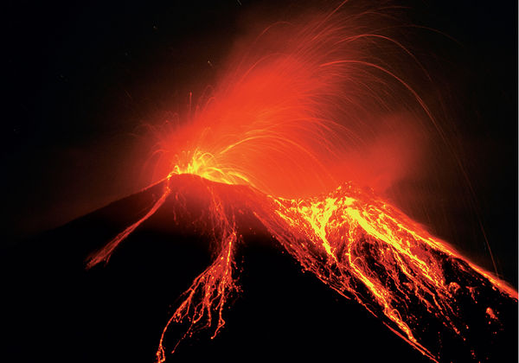
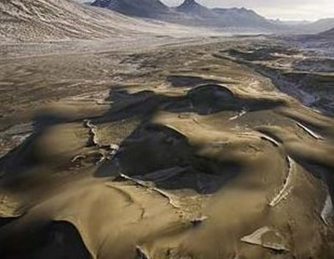
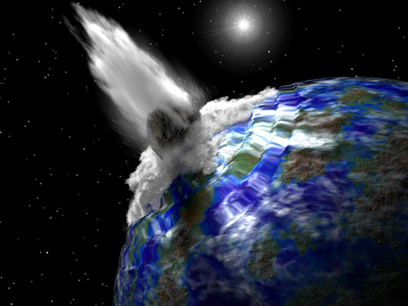
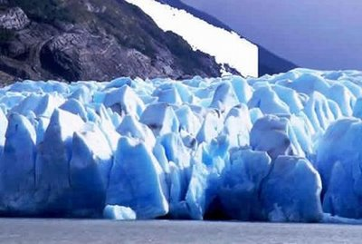
Seven Reasons to Believe
Fourth
The firsts organisms survived in extreme conditions

Slide 10
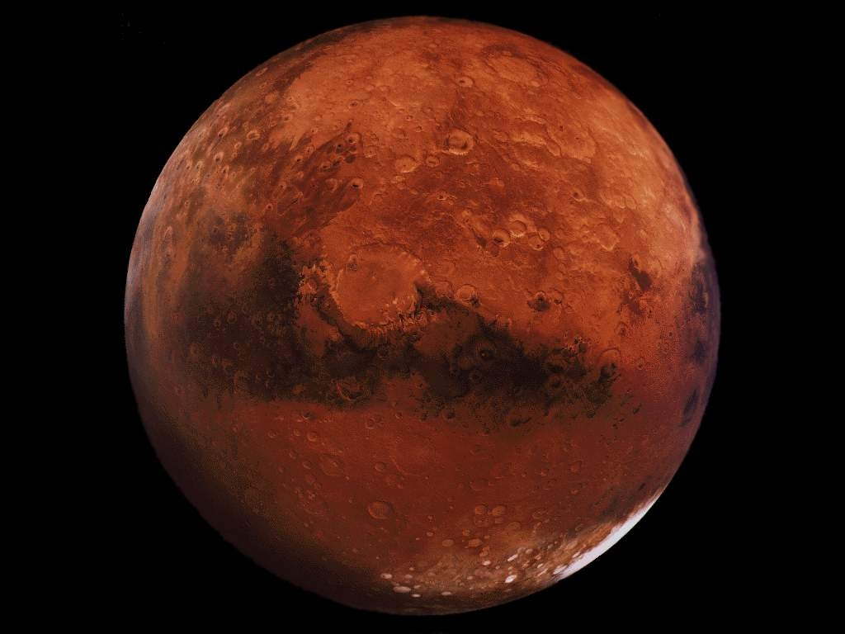
Seven Reasons to Believe
Fifth
How life originated on Earth.
Mars

Slide 11
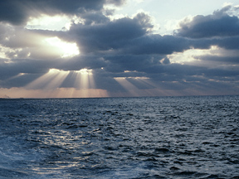
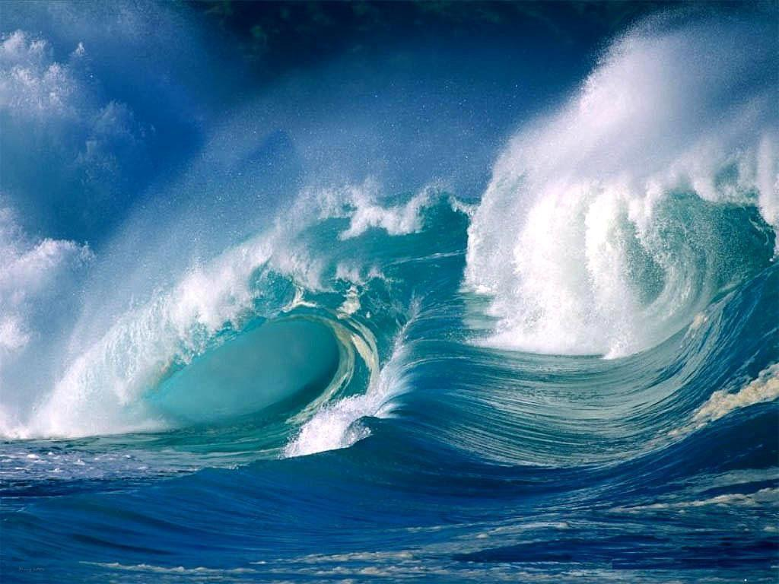
Seven Reasons to Believe
Sixth
Oceans and rivers on another planets and moons

Slide 12
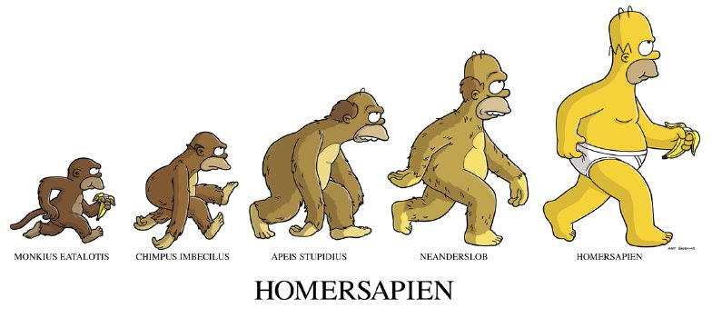
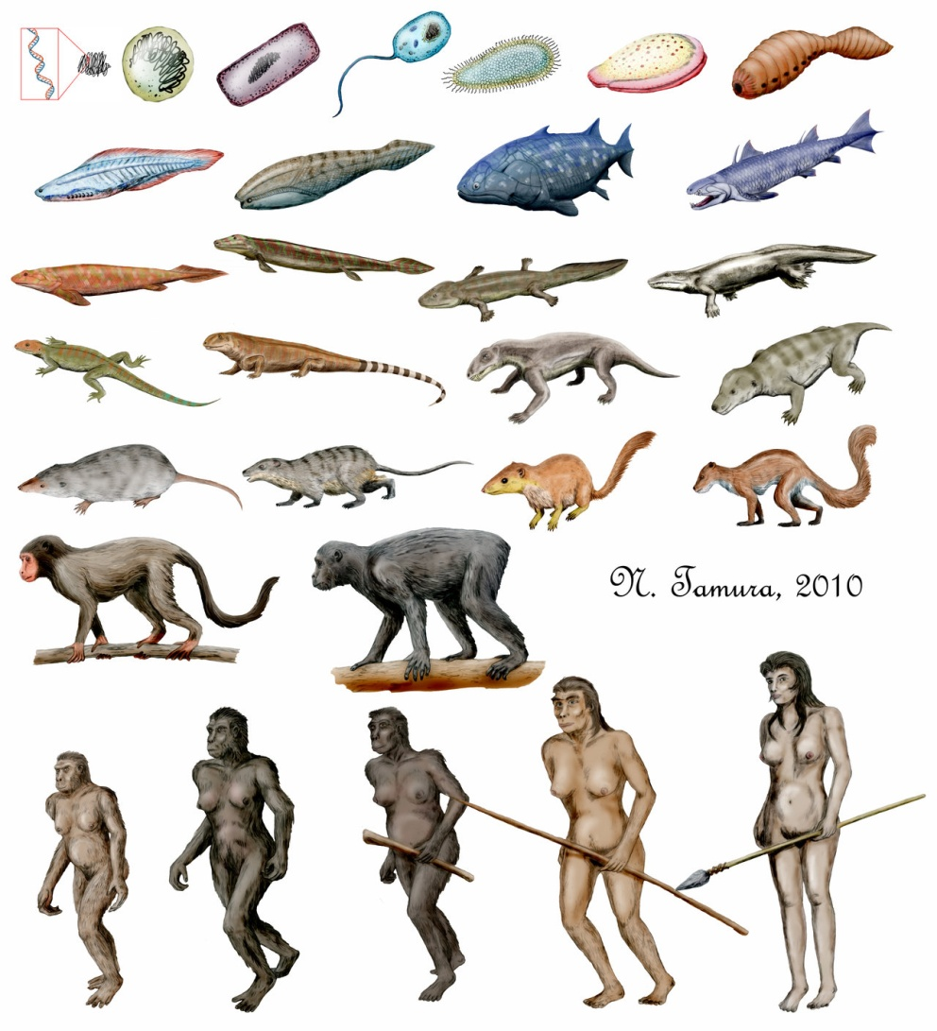
Seven Reasons to Believe
Seventh
Evolutionary theory

Slide 13
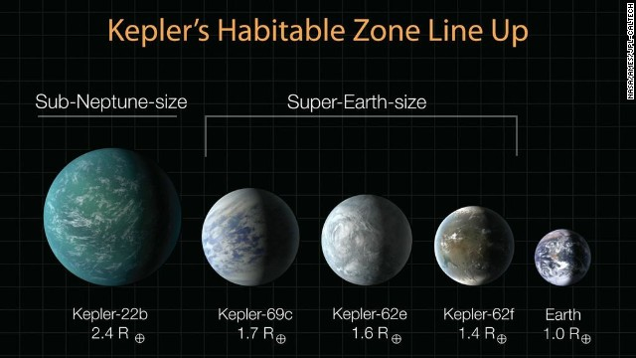
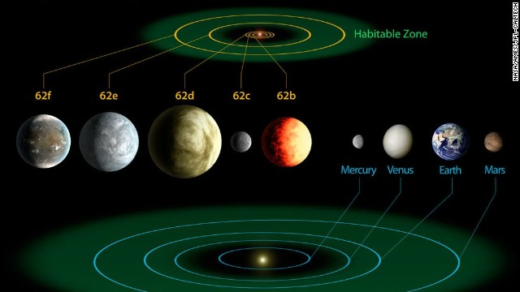
Last News
“3 new planets could host life”
What is habitable zone?
This diagram compares the planets of our own inner solar system to Kepler-62, a five-planet system about 1,200 light-years from Earth. Kepler-62e and Kepler-62f are thought capable of hosting life.

Slide 14
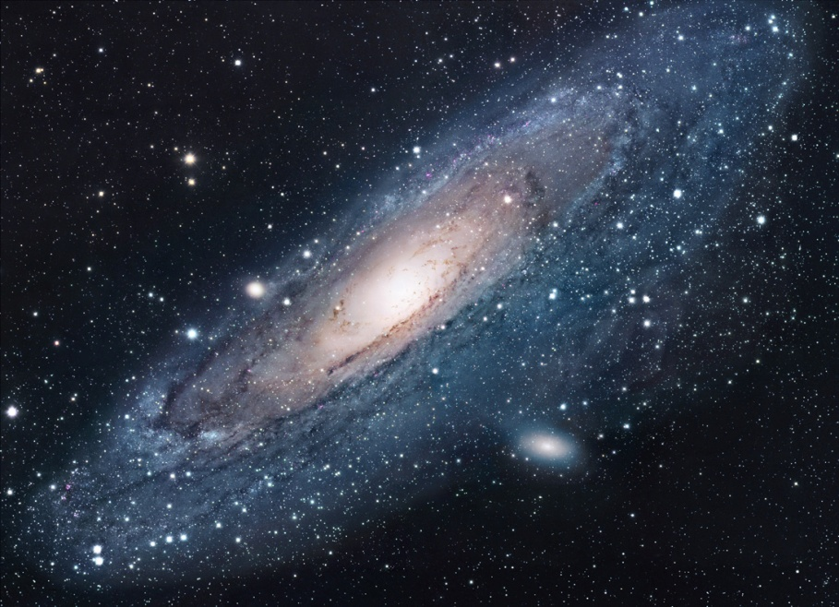
Things to Think About and Go Crazy
Where are we?

Slide 15
Things to Think About and Go Crazy

Slide 16
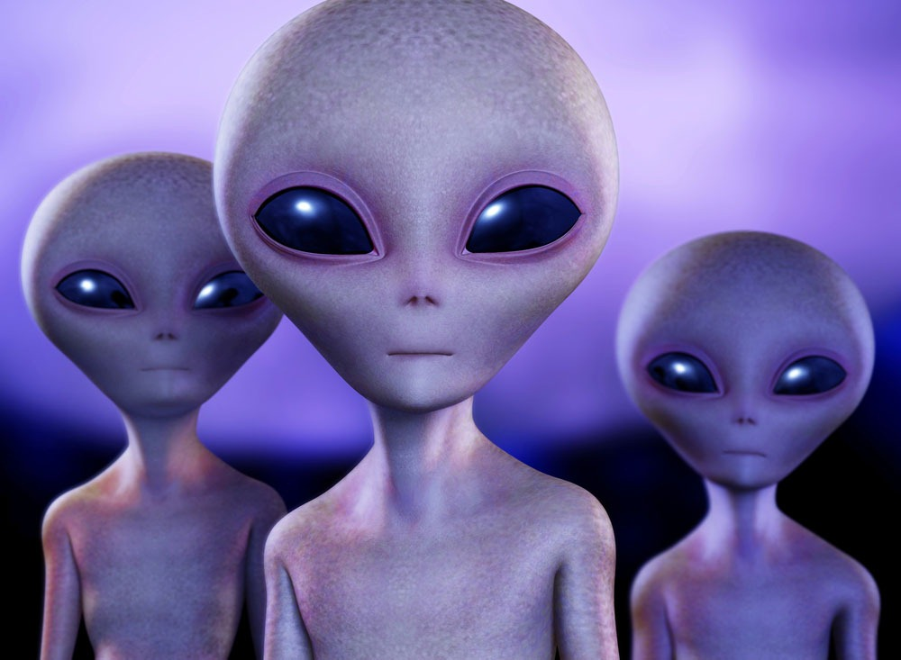
Conclusion
They are in some place !

Slide 17
Sources
http://www.dailymail.co.uk/sciencetech/article-2370047/Life-Mars-Spacecraft-finds-life-existed-Mars-billions-years-ago.html
http://hypescience.com/nao-existe-vida-inteligente-fora-da-terra-segundo-cientista/
http://www.cnn.com/2013/04/18/us/planet-discovery/index.html
http://www.youtube.com/watch?v=Llhbhw3QZdc
http://io9.com/5969106/7-good-reasons-why-there-might-be-life-on-other-planets
http://en.wikipedia.org/wiki/Primordial_soup
http://www.youtube.com/watch?v=HNZwIC_cPMs

