Slide 1
Titanic The Only Trip
By
Abdullah Alzaydany

Slide 2
Outline
How it begun
Construction
Safety Features
What happened
Numbers
Sources

Slide 3
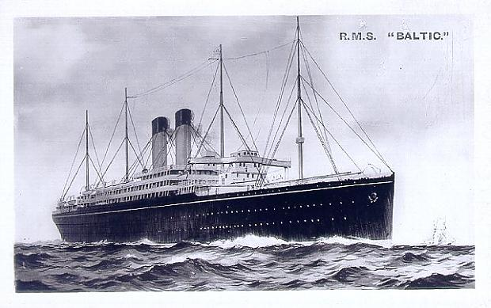
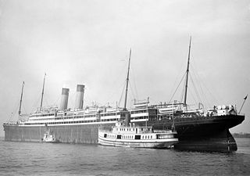
How it began
White Star Line:
Baltic (1905). The largest
Adriatic (20 Sep 1906). The fastest.
Cunard Line:
Mauretania (20 Sep 1907).
The fastest and largest ocean liner.

Slide 4
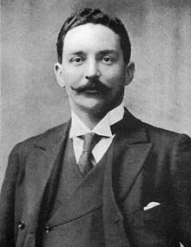
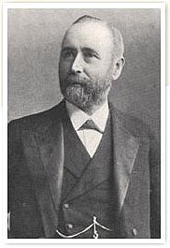
How it began
On 29 July 1908, White Star Line approved the designs produced by Harland and Wolff.
In 1907, J. Bruce Ismay and Lord Pirrie had dinner.

Slide 5
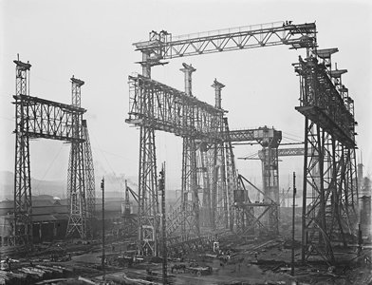
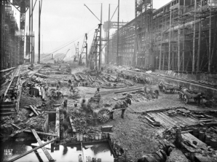
Construction
They had to build new slipway called (Great Gantry).
$ 160.000

Slide 6
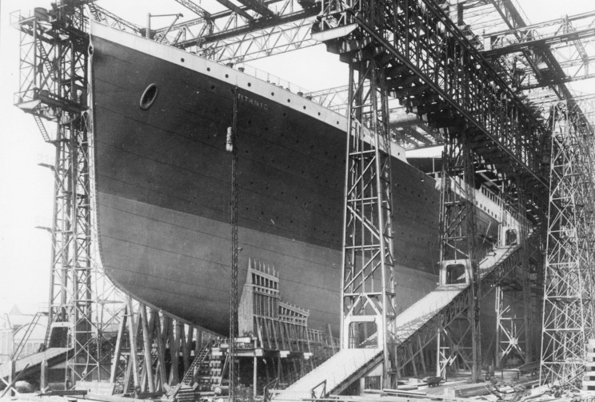
Construction
On 31 March 1909, the Titanic started to be built.

Slide 7
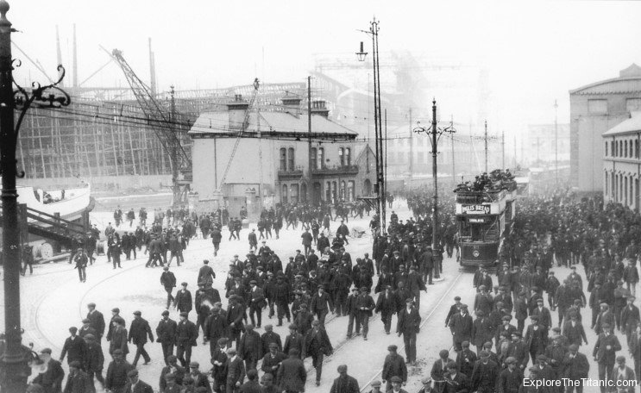
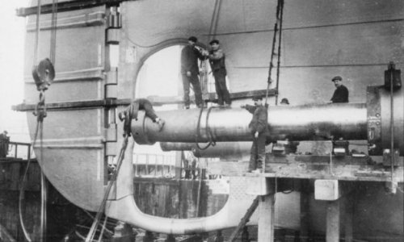
Construction Facts
15,000 employees were building the Titanic.
8 people died during the constructions.

Slide 8
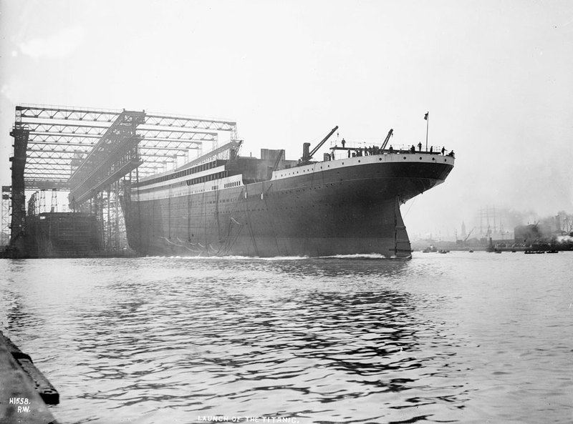
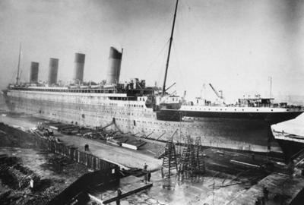
Construction
On 31 May 1911, the Titanic was launched.
They needed 22 tons of soap and tallow to move it.
Then, it was fitted out later on.

Slide 9
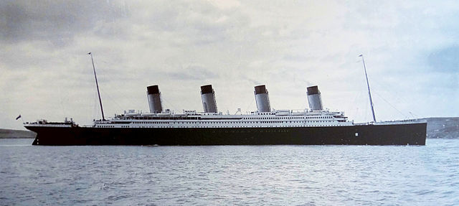
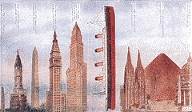
Construction
Length: 269 m (882 ft).
Width 28 m (92 ft).
Height 35 m (175 ft)
The titanic was completed on 2 April 1912.
Cost of the Titanic (in 1912): $7,500,000 Today: over $400,000,000

Slide 10
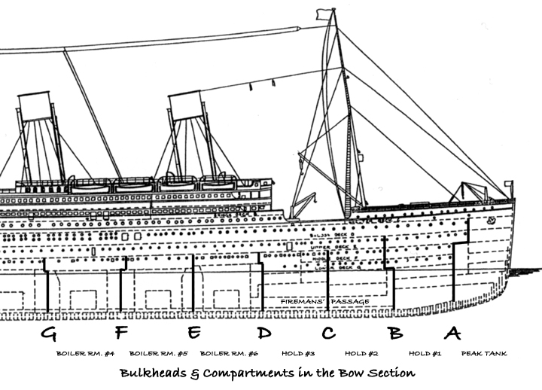
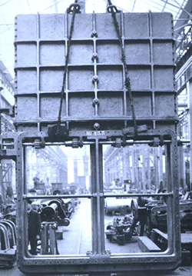
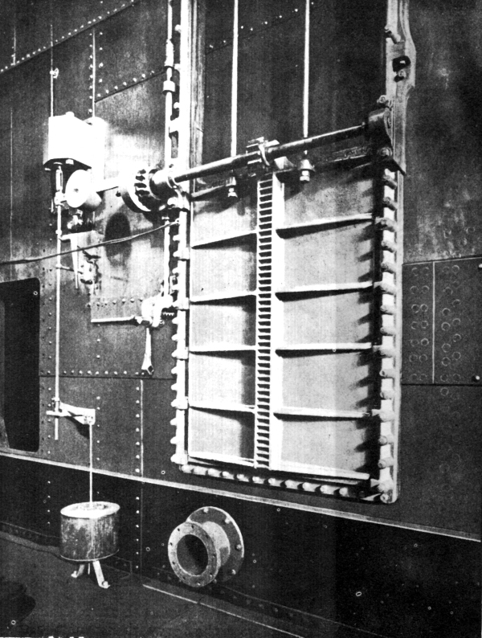
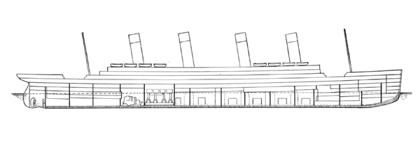
Safety (Watertight)
15 Watertight barriers divided hull into 16 watertight box.
The titanic has 10 decks A-J.

Slide 11
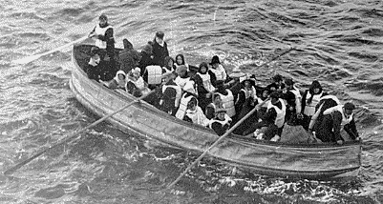
Safety (Lifeboat)
It will look unsightly.
Passengers in first class would like open space.
The Board of Trade's regulations required British vessels over 10,000 tons to carry 16 lifeboats.
There were 20 lifeboats enough for 1,178 people.
3,327 passengers.
64 lifeboats

Slide 12
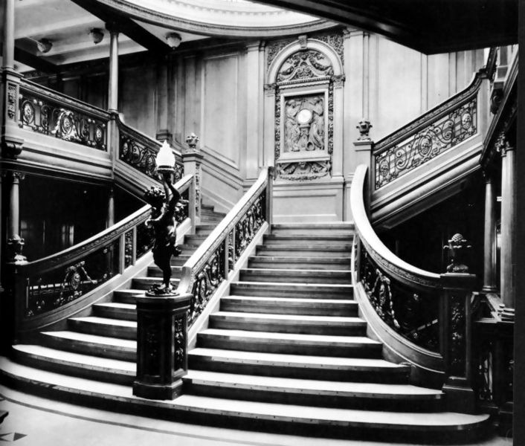
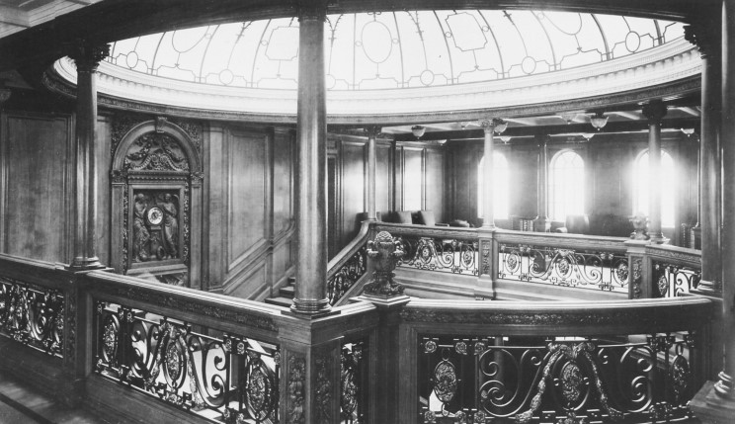
Inside Titanic
Grand Staircase

Slide 13
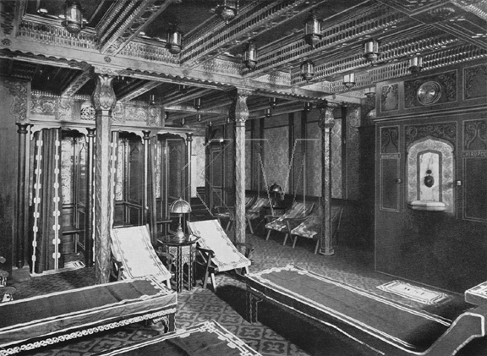
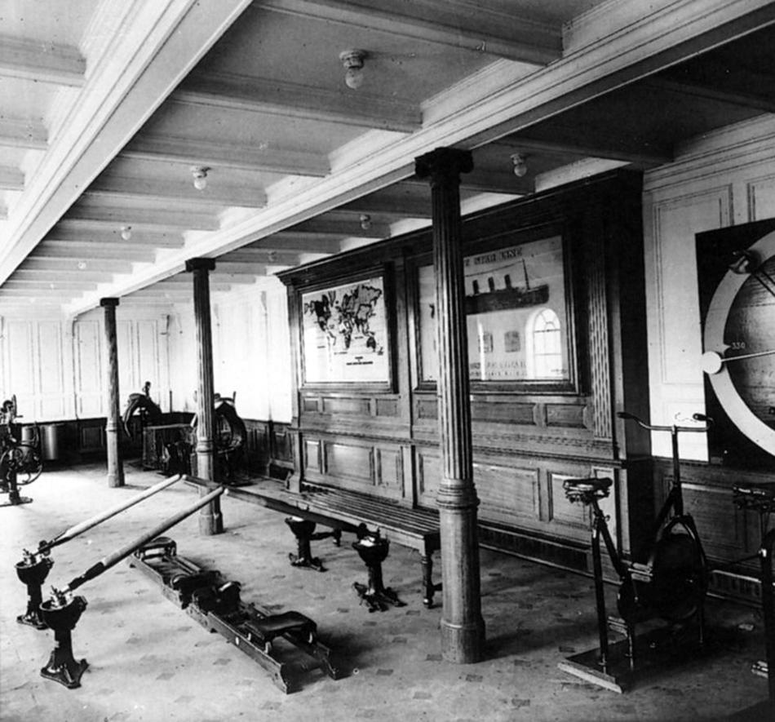
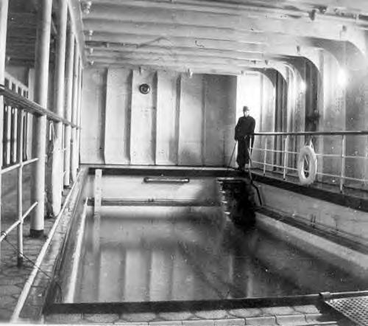
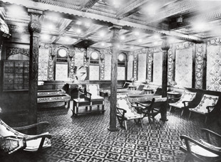
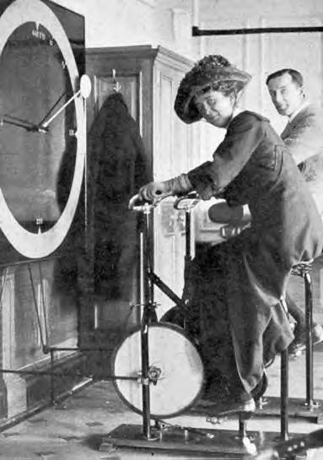
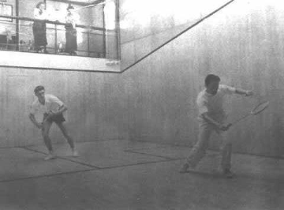
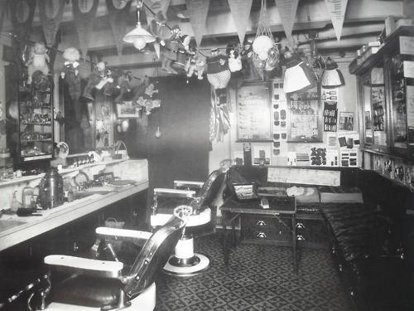
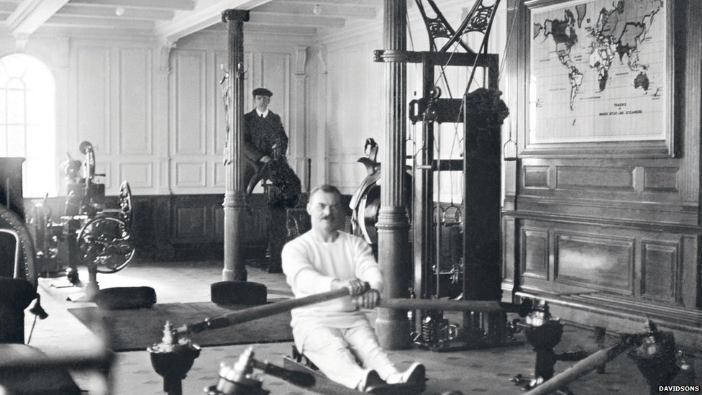
Inside Titanic
Barber Shop
Swimming Pool
Squash Court
Gymnasium
Turkish Bath

Slide 14
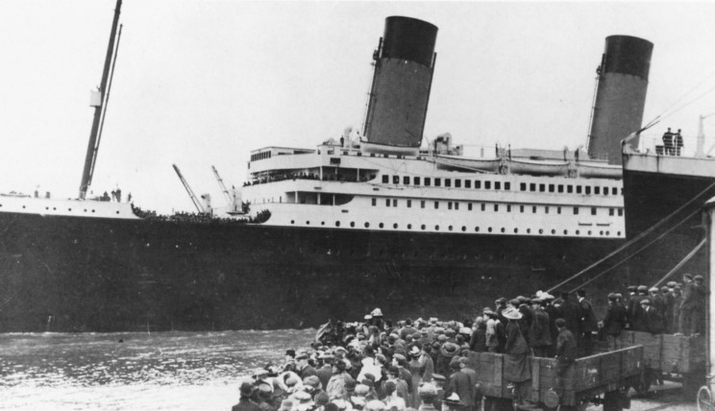
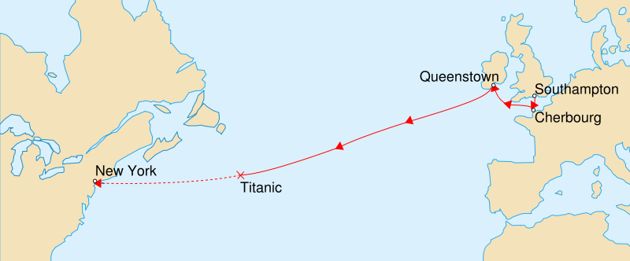
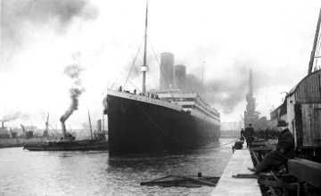
What happened
The titanic departed on 12 April 1912 from Southampton, England.
Cherbourg, France.
Queenstown, Ireland.
There was a coal strike in 1912.
Titanic consumed 600 tons of coal a day.

Slide 15
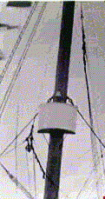
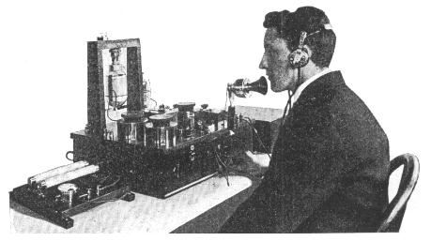
What happened
They had two warning system
Marconi wireless. 2. crows nest.

Slide 16
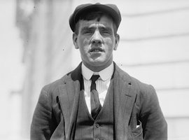
What happened
It was 11.40 p.m. 14 April 1912.
"Iceberg right ahead!"
After 37 seconds the ship began to slide into the iceberg.
Frederick Fleet

Slide 17
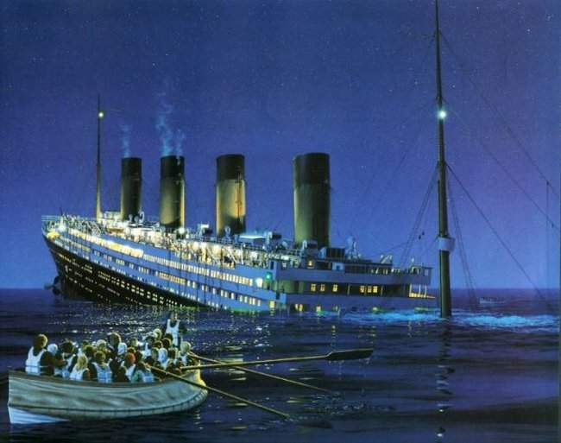
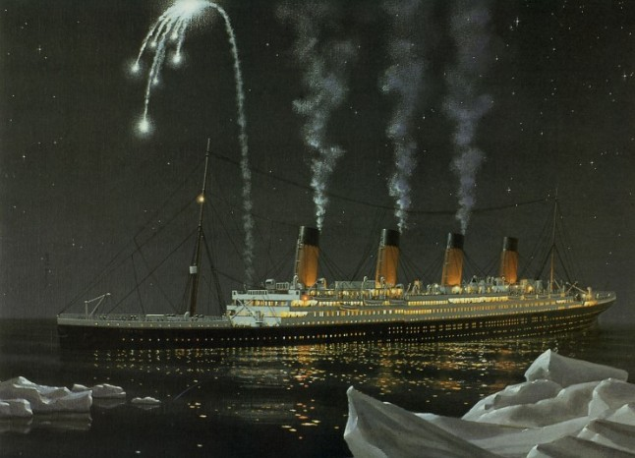
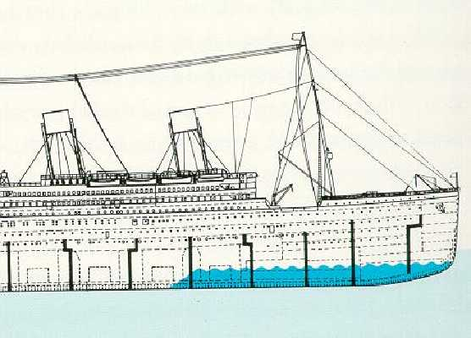
What happened
Five compartments were damaged.
The Californian ship was 10 miles away, but the operator didn’t pick up message.
By 12.10 a.m. the first lifeboat was lowered.
Another ship picked up, but it was 58 miles away.
They started to fire rockets.
300 feet gash.

Slide 18
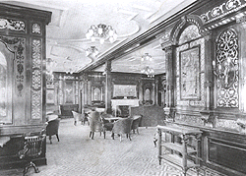
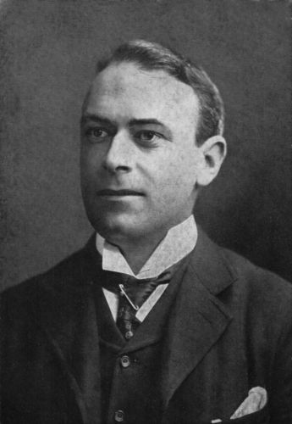
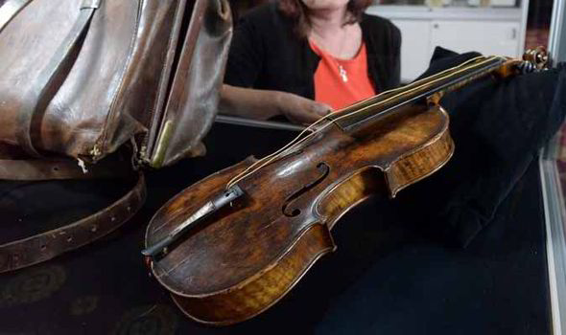
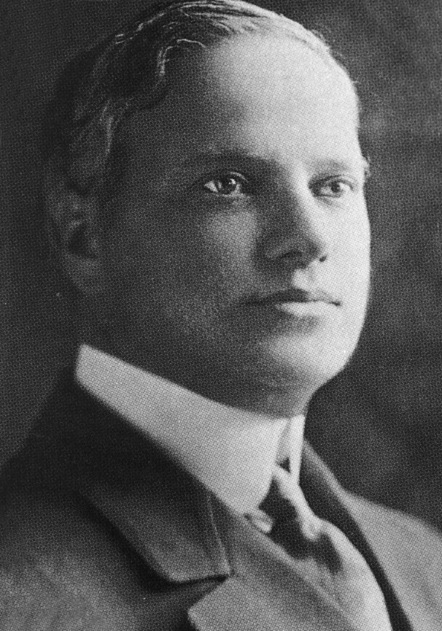
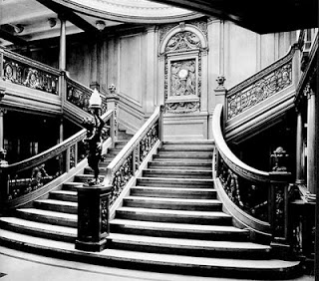
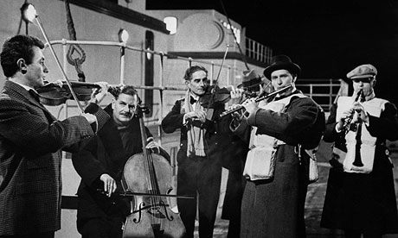
What happened
Thomas Andrews, the designer of the ship, was waiting his fate in the smoking room.
At 1:30 third class passengers were allowed to be in boat beck, but it was too late.
The band was singing while the Titanic was sinking. “nearer my god to thee”
Benjamin Guggenheim, an American businessman:
"We've dressed up in our best and are prepared to go down like gentlemen."

Slide 19
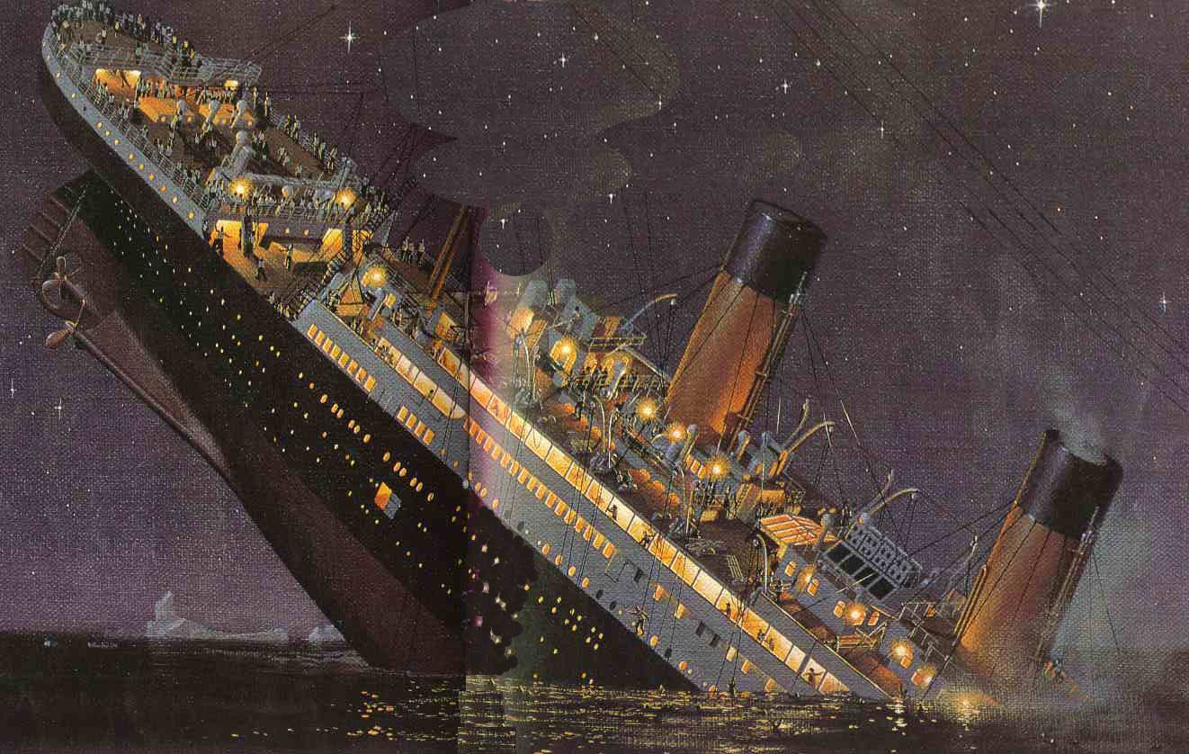
What happened
At 2:20 the Titanic sank.

Slide 20
Numbers
Passenger category | Number saved | Number lost
Children | 56 | 53
Women | 296 | 106
Women, crew | 20 | 3
Men | 146 | 659
Men, crew | 192 | 693
Total | 710 | 1514

Slide 21
Sources
http://www.titanicandco.com
http://en.wikipedia.org
http://www.youtube.com
http://www.titanic-titanic.com

